Slide 1



Installing anaconda & vscode

Slide 2
Installing Anaconda

Slide 3

Notes:
https://www.anaconda.com/

Slide 4
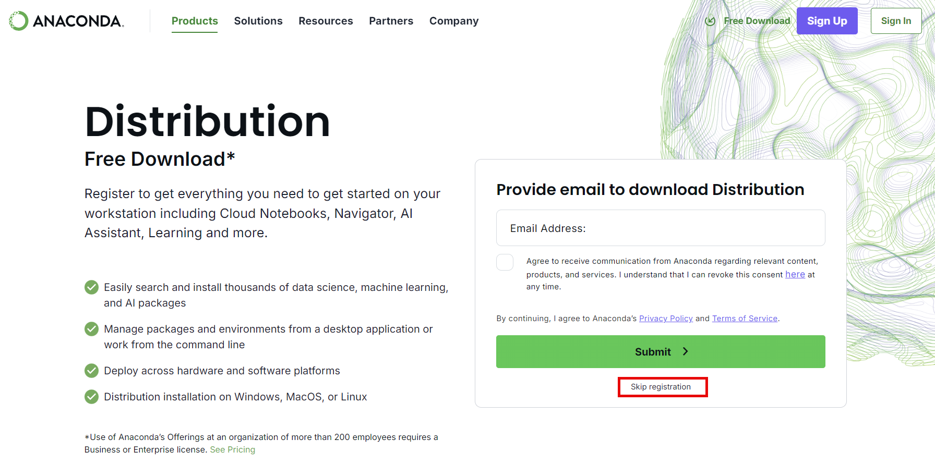
Notes:
https://www.anaconda.com/download/

Slide 5
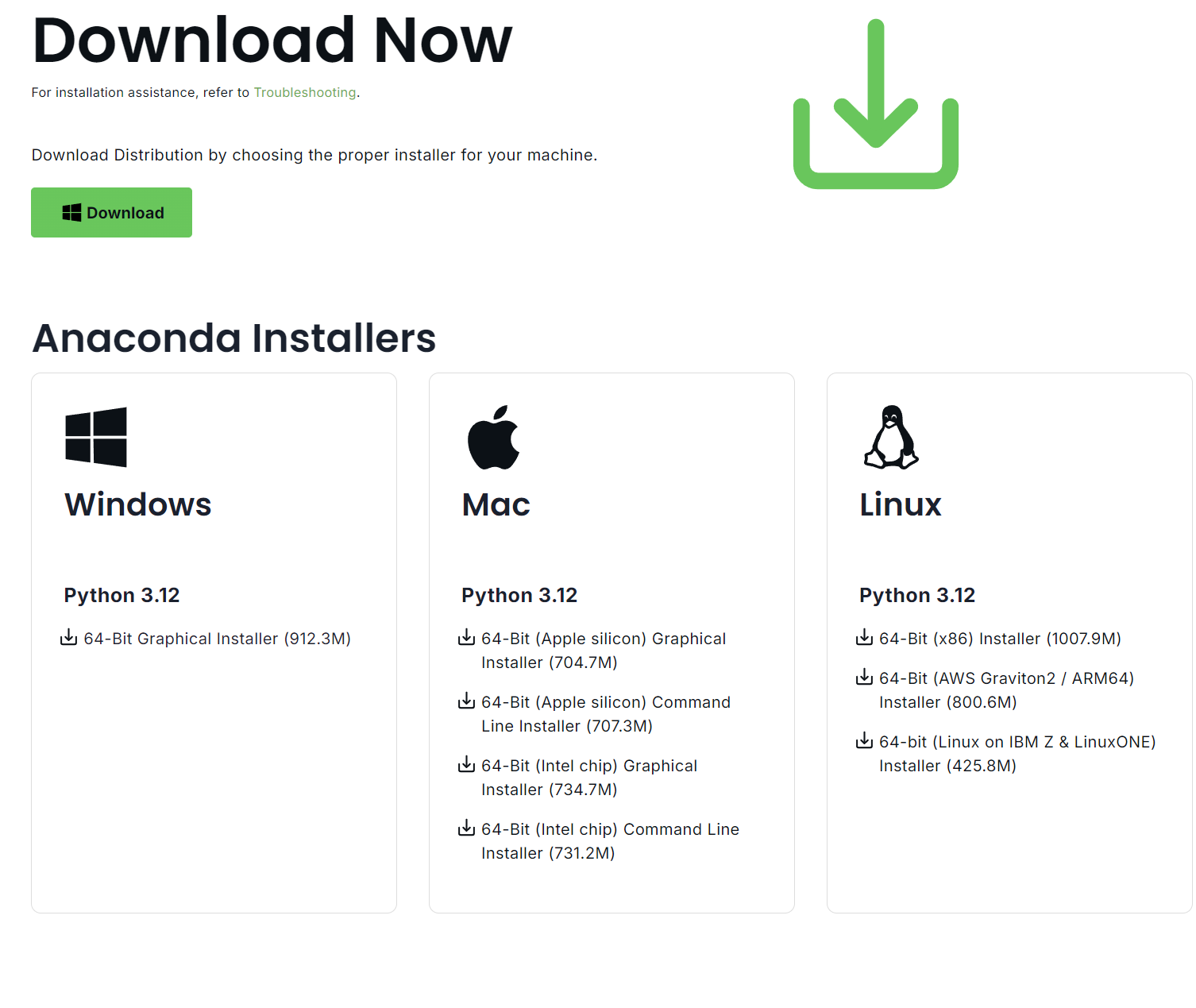
Notes:
https://www.anaconda.com/download/success

Slide 6
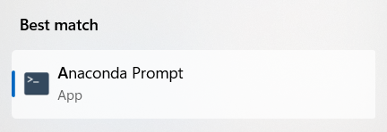
conda create --name datascience_core --clone base
conda activate datascience_core

Slide 7
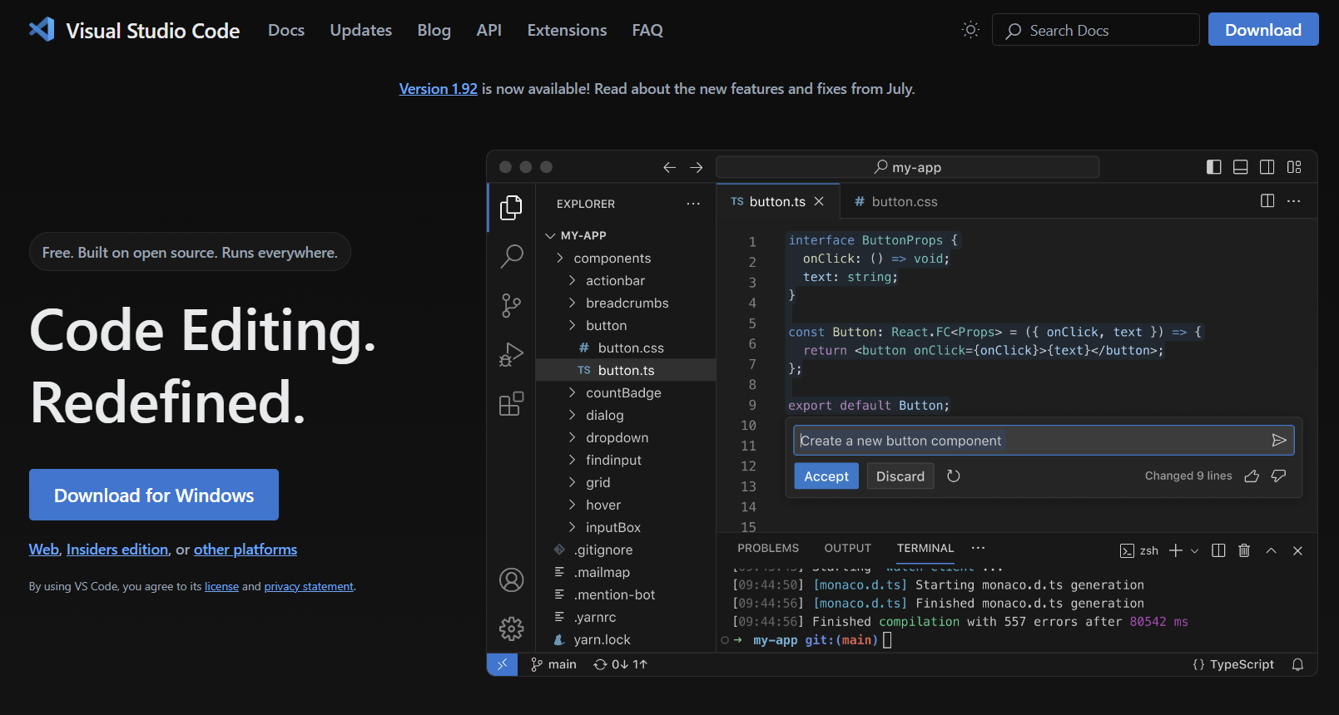
Notes:
https://code.visualstudio.com/

Slide 8
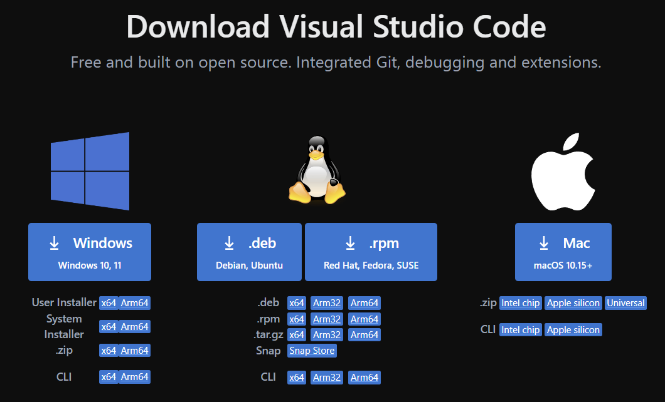
Notes:
https://code.visualstudio.com/download

Slide 9
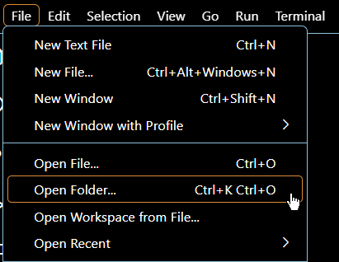
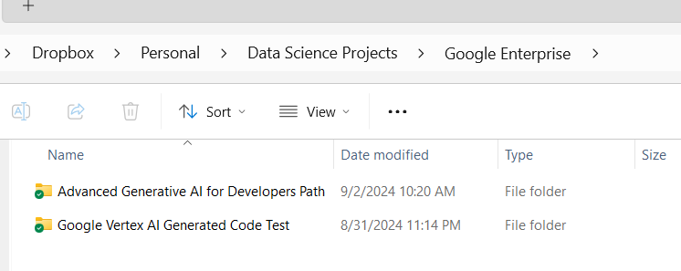

Slide 10
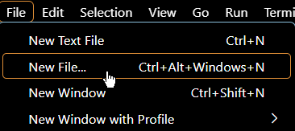
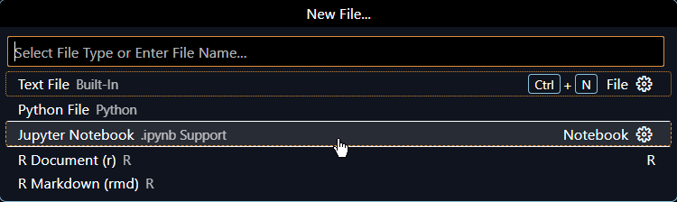

Slide 11
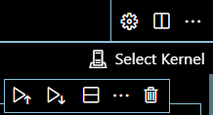
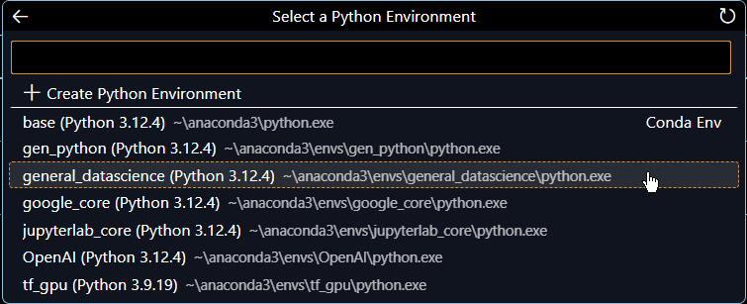

Slide 12
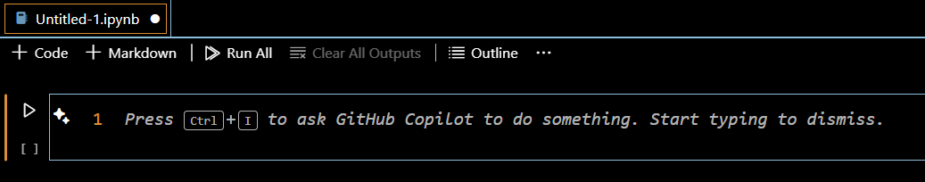
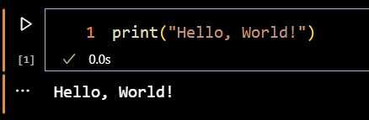
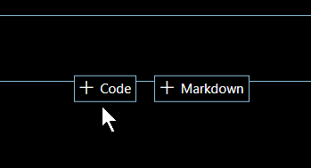

Slide 13


